Slide 1
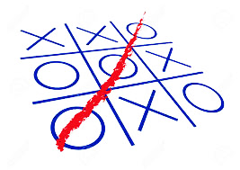
TIC Tac Toe
DEGISN AND ANALYSIS OF
Algorithm Project by
Aashay Pandit
Aditya Hegde
Amodh Budnimath

Slide 2
INTRODUCTION
Tic-tac-toe is a simple, two-player game which, if played optimally by both players, will always result in a tie. The game is also called noughts and crosses or Xs and Os.Tic-tac-toe is a game that is traditionally played by being drawn on paper, and it can be played on a computer or on a variety of media.
We have here tried to implement the game in c++ language where you play against computer to get either 3 Xs or 3 Os in row column or diagonally to win.

Slide 3
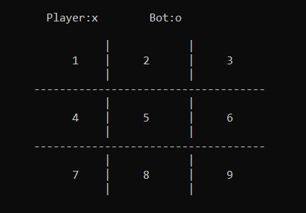
How to Play :
Step 1 : The game is played on a grid that's 3 squares by 3 squares.
Step 2 : Player is ‘x’ , the computer is ‘o’ . Players take turns putting their marks in empty position by entering position number as shown above.

Slide 4
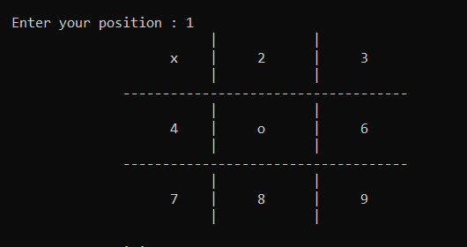
Step 3 : After player enters their position bot automatically puts ‘o’ at its favoured position and again returns back to player to enter next position.
Step 4 : This happens until either Player or Bot wins.

Slide 5
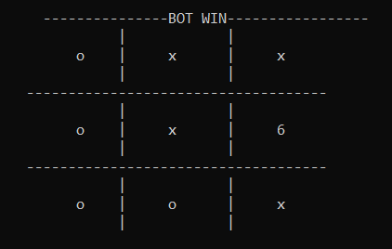
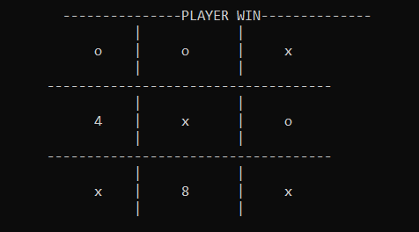
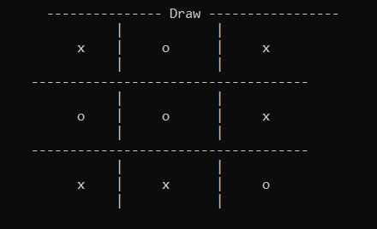
Step 5 : There are three possible way a game can end either Bot has to wins or Player has wins or it will be a Tie at which point the program will stop and either of following outputs will be displayed.
BOT WIN PLAYER WIN DRAW

Slide 6
Question ?
OR
CAN ANYONE BEAT OUR BOT ?

